Slide 1

ECIS: A Web Application
for EARIST Clinic
Student's
Medication and Medicine Inventory System
Heroda, Marvin Terrence *
Dizon, Ayeka Mae
Castuera, Marinella
Blanco, Riann Alic
Dagar, Mark Angel

Slide 2

Introduction
Management system to hold efficient record
Manual system to automated system
Improve care quality and quantity of medical information
Provide Medical services, health programs, health monitoring and profiling

Slide 3

Management System
Manual system to automated system
Recording patient medical information
Faster consultations
More effective treatment, and ultimately improved health outcomes for patients
Management System
- Analysis for quality assessment
- Identification of areas for information
- Support tools
- Medication alerts

Slide 4

Objectives
Implement digitization of medical records
Providing access to medical records in an emergency
Providing a more efficient method
Secured patient information

Slide 5
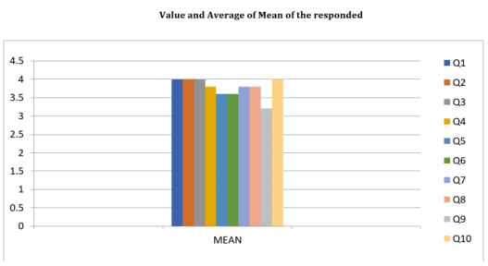
Methodology
This study is used a mean, median, and mode to calculate the parameters such as responded. The mean is that used method for finding the average. To find mean just simplify add all the response .
To find the mean is need to add the value of respondents and divide by how many responded to each question. The total responded is called N. For Value is called V and this is the final estimated. Then the median is the number in the middle.

Slide 6
Design
The study's design is as follows: [i] utilizing a csv file to collect data, (ii) creating a column named question to view the mean of each question's response. (iii) Applying the descriptive method such as frequency distribution, central tendency and dispersion.

Slide 7
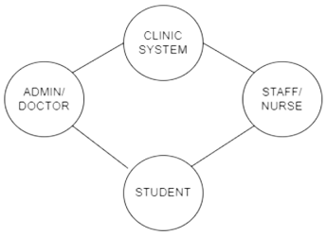
Results & Discussion
The graph depicts the school clinic's performance. The researcher will look at the clinic school's system.

Slide 8
*Graph of school clinic system*

Slide 9
*Applying Dataset*

Slide 10
*Response of the respondents*

Slide 11
*View the means of each response*

Slide 12

Conclusion
Executing job efficiently and saving time by the use of technology
ECIS Web Application can lessen the work load of clinic stuff
Solving healthcare field concerns

Slide 13
Limitation & Future Works

Slide 14

ECIS: A Web Application for EARIST Clinic Student's Medication and Medicine Inventory System

